Slide 1
Learn Operating Digital Storage Oscilloscopes (DSOs)
Rupesh Gupta
Wadhwani Electronics Laboratory
IIT Bombay

Slide 2
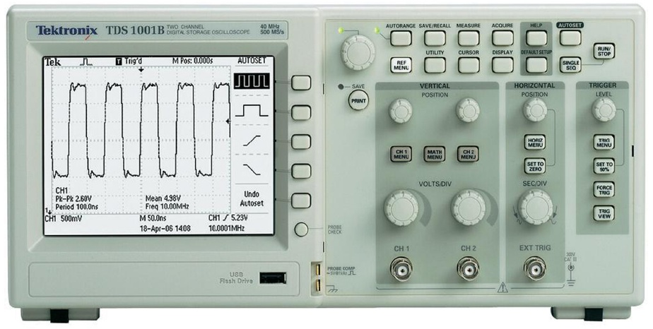
Digital Storage Oscilloscope (DSO)

Slide 3
First Step:
Connect the probe to the probe check pins and a nice square wave of 0V to 5V should be observed on the screen.
If not, press the ‘auto-set’ button on the DSO panel for the very first and the very last time !!!
Note: During the learning process in case if the signal display goes out of the display window, use the scaling and positioning knobs as will be discussed in the next 4 slides.

Slide 4

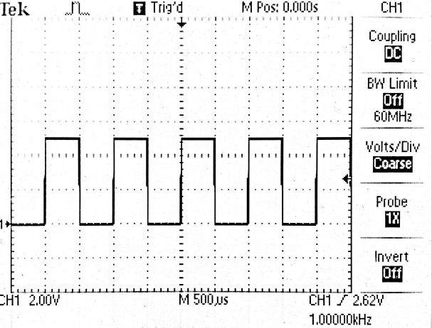
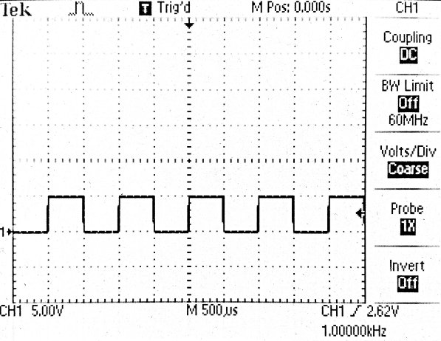
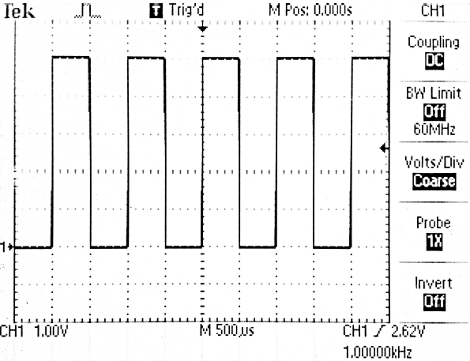
What do the knobs do?
Volt/Div
Volt/div knob :-
It varies the scaling of the vertical axis/voltage axis. As one rotates the knob on the left, volt/div increases hence vertical zooming out shall be observed keeping the magnitude of the signal same. And vice versa on rotating it on the right. This knob is specific to the channel and hence number of these knobs is equal to the number of channels available on the DSO.
Scale
value
knob rotated left
(scaling increased)
knob rotated right
(scaling decreased)

Slide 5
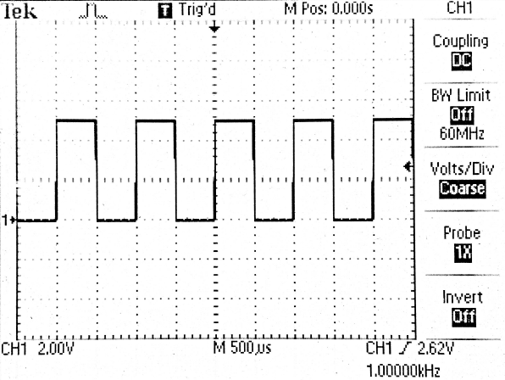
What do the knobs do?
Vertical Pos.
Vertical Position knob :-
It varies the vertical positioning of the signal on the screen. On rotating this knob both the signal as well as the reference value moves vertically on the signal display window. This knob is also channel specific as that of volt/div knob.
Reference
pointer
Signal shifts vertically
on the display

Slide 6
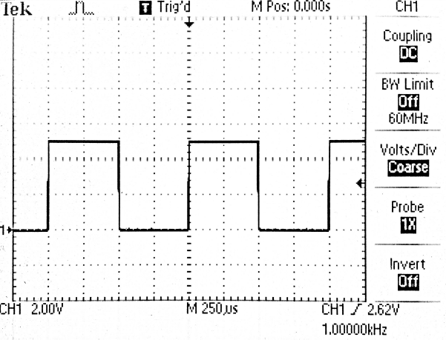
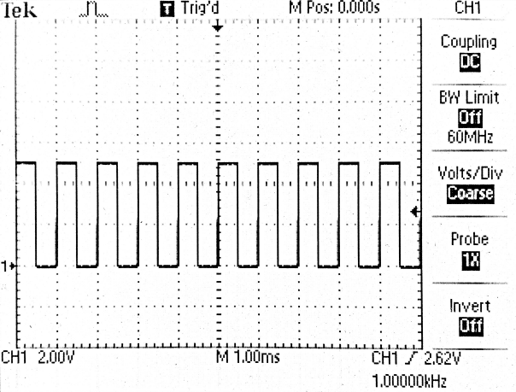
What do the knobs do?
Time/Div
Sec/div knob :-
It varies the scaling of the time axis or the horizontal axis. On rotating left the time/div increases and hence more number of oscillations would be observed within the same division. And vice versa on rotating it right. This knob is not channel specific and will be used for all the channels simultaneously.
knob rotated right
(scaling decreased)
knob rotated left
(scaling increased)
Time scale value
Note: On increasing the time per division to a large value near or above 100 msec (persistence of vision) one could observe the signal actually
traveling in time on the screen.

Slide 7
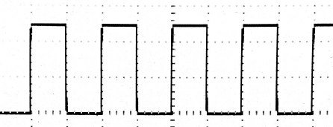
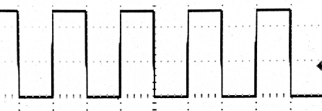
What do the knobs do?
Horz Pos.
Horizontal Position knob :-
It varies the horizontal positioning of the signals on the screen. On rotating in left the signal display will move on the left and on rotating right signal will more on the right.
This knob is channel non specific as that of sec/div knob.
Signal shifts horizontally
on the display

Slide 8
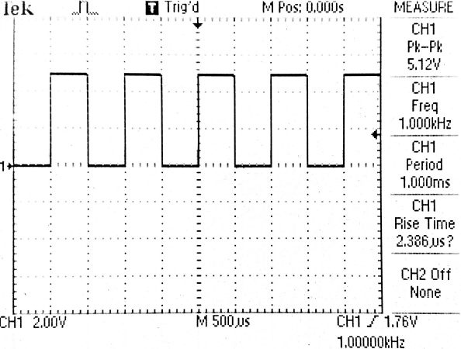
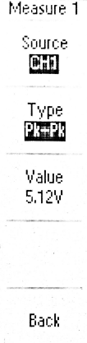
What does the Measure button do?
Measure
This displays various parameters of the connected signal. On pressing this button, one has to select the channel and the parameter to be determined through the options pane. Parameters available are pk-pk, mean, rms, max, min, freq, period, rise time, fall time, positive width and negative width.
Most of these values could be vaguely determined from the display itself by counting the divisions and subdivisions and multiplying it with the scaling factor.
Channel Selection
Parameter selection
Parameter value
On pressing any button
in options pane after
Measure button is
Pressed

Slide 9
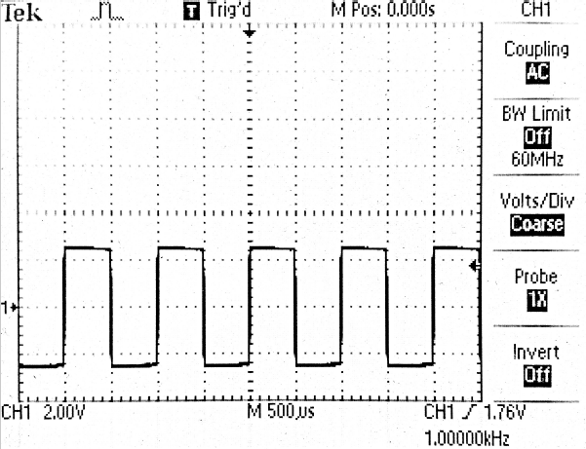
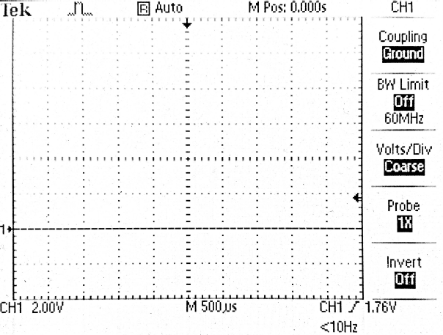
What does the Channel Menu button do?
Its first basic operation is to turn on/off the channel display on the screen. These buttons are channel specific. It has a set of options visible in the options pane on the display.
Option 1: Coupling – DC/AC/Ground
DC coupling – complete signal is represented on the display.
AC coupling – only the AC part of the signal is displayed and the DC part of the signal is removed.
Ground Coupling – horizontal line appears on the screen representing the reference line for that particular channel connecting the reference pointer on the left.
0 to 5 Volts
-2.5 to 2.5 Volts
DC offset
Reference
Ground
Reference
Ground
Reference
Ground
DC coupling
AC coupling
Ground coupling

Slide 10
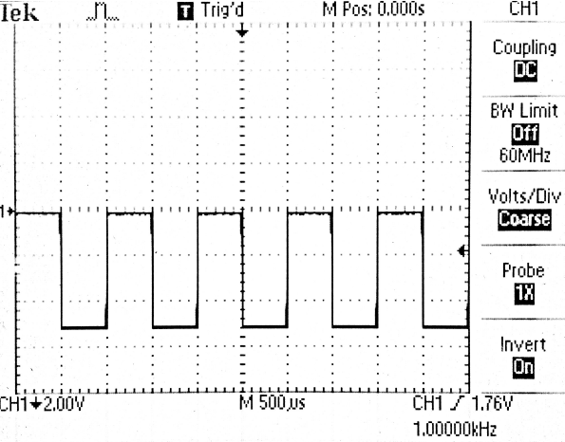
What does the Channel Menu button do?
Option 2: Bandwidth Limit (off/on) – limits the bandwidth of the signal to be viewed on the screen. This is used to remove high frequency noise (in tens of MHz) from the signal.
Option 3: Volt/div knob setting – This is used for setting the volt/div knob scaling as coarse or fine tuned. Coarse setting is default and in this setting rotating volt/div knob scaling varies in discrete steps whereas in case of fine setting this scaling varies very smoothly (used for precision purpose).
Option 5: Invert – This option inverts the vertical axis and hence signal also inverses.
(Used for better presentation of negative valued signals)
voltage
time
time
voltage
Down arrow representing
axis inversion

Slide 11
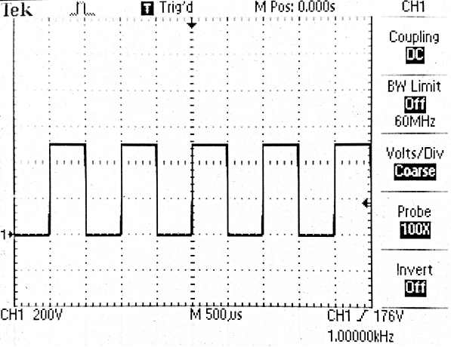
What does the Channel Menu button do?
Ch. Menu
Option 4: Probe multiplier setting – Used for multiplying the signal by appropriate factor. (Only the display magnitude changes but the actual signal remains intact). This option is meant for better interaction of the represented signal to the user.
Only signal scaling
Changes while keeping the
signal display same.
Setting :1x
Setting :100x
Scale : 2V/div
Scale : 200V/div
Eg, Let the probe is used at an attenuation of 10x, the measured signal is divided by 10 and this signal with altered magnitude is displayed. But in order to view the actual value multiplier of 10 could be used for compensating the effect of probe attenuation.
Another feature in newer versions is to set the display setting to current instead of voltage that shall be found to be useful while measuring currents as the current sensors give current values in terms of voltages.

Slide 12
What does the Acquire button do?
This specifies the data acquiring type used for displaying the signal on the screen.
Option 1: Sample – Displays the signal with samples equal to sampling rate of the DSO.
Option 2: Peak Detect
Option 3: Average – Displays the signal after averaging the number of samples specified by the fourth option. Averaging sometimes is used for removing the noise from the signal.
Option 4: Samples for Average – 4/16/64/128

Slide 13
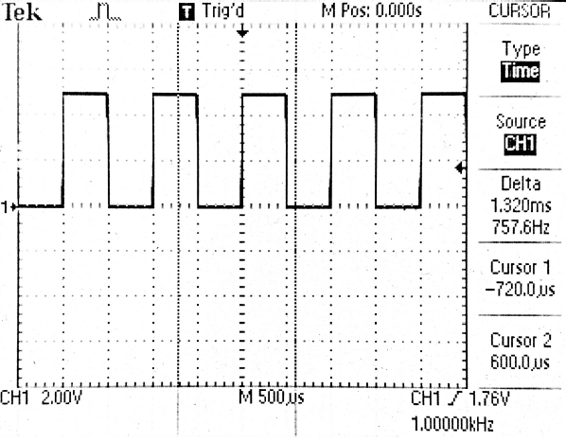
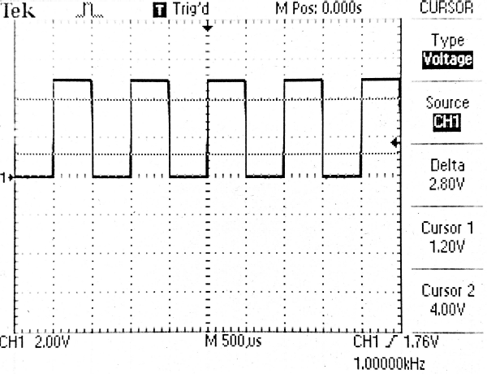
What does the Cursor button do?
Cursor
It turns on/off the cursors on the screen. Any point on a 2-Dimensional display could be displayed by a x and y value which are time and voltage values respectively.
First option is to turn on/off the cursors .
Amplitude or the voltage cursor are two horizontal cursors observed on the screen. Voltage cursors are specific to the channel and will represent value depending upon the corresponding channel scaling.
Time cursors are two vertical cursors observed on the screen. These are channel non specific and represent values depending upon the sec/div scaling.
Horizontal/Voltage
cursors
Vertical/Time
cursors
Cursor Values
The cursor positions could be altered by using vertical position knobs in the older models while using the big multipurpose knob in the newer versions.

Slide 14
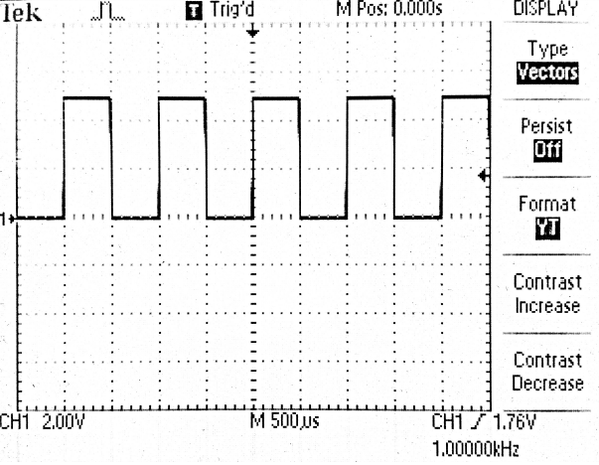
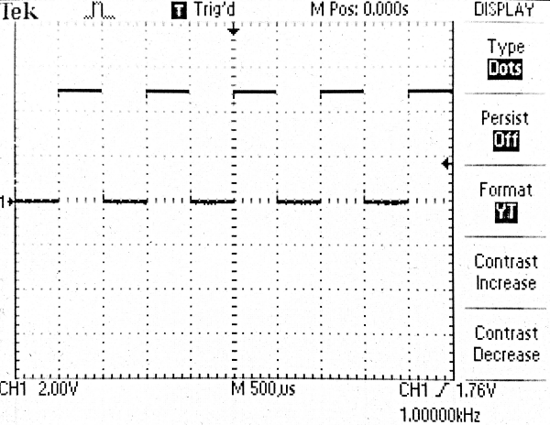
What does the Display button do?
This is used for varying the presentation of the display.
Option 1: Type
Vectors – It is the default setting.
Dots – In this the signal is represented by 3200 dots on the display. Vectors are formed by connecting these dots by straight lines.
These could be distinguished only if slope of the signal at certain points in the signal is very high.
Vector type display
Dots type display

Slide 15
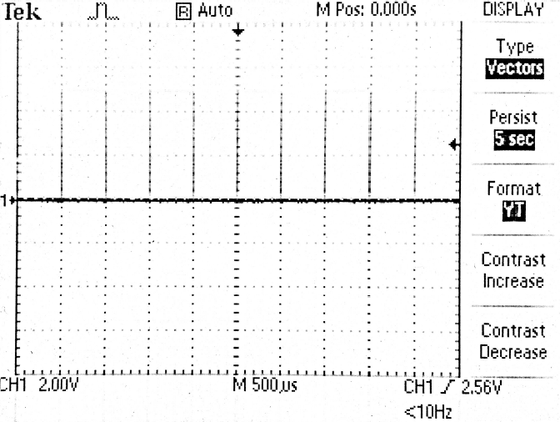
What does the Display button do?
Option 2: Persist – This allows the signal to persist or stay on the screen for the defined amount of time even after the probe pin is connected to a different signal. The initial signal gradually blurs out.
One could try this out by setting the persist option to say 5 sec. Remove the probe pin from the probe check and the square wave gradually blurs out.
Signal disappearing gradually

Slide 16
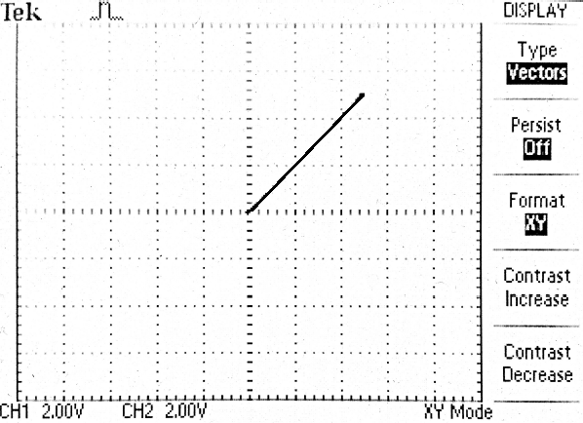
What does the Display button do?
Display
Option 3: Format
YT format – The signal will be displayed with respect to time.
XY format – The signals will be displayed with respect to each other i.e. one channel represent the horizontal axis and other channel represent the vertical axis.
For XY format it is advised to keep both the channel scaling equal and keep the references of both the signals at the vertical centre of the screen for better inference from the observed shape on the display. This format generates patterns commonly referred as Lissajous patterns.
This could be tried out by putting two probes connected to the probe check option and a straight line with slope x=y from point (0,0) to (5,5) shall be observed.

Slide 17
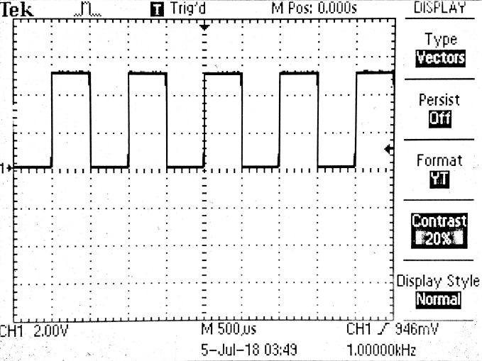
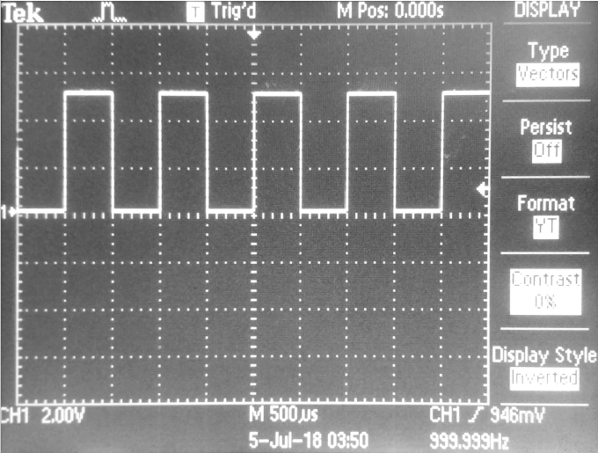
What does the Display button do?
Option 4: Contrast – For varying the contrast of the display.
Option 5: Display style
Normal – Black text and figures in white background.
Invert – White text and figures in the black background.

Slide 18
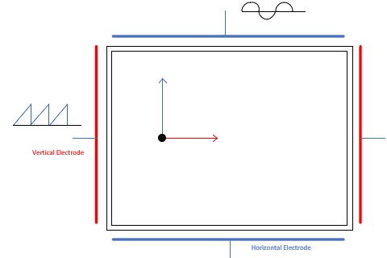
Triggering Phenomenon
Two set of parallel electrodes vertical and horizontal are used to display the signal on the screen. In YT display mode i.e. when signal is displayed with respect to time, a ramp signal is given on the vertical electrodes that are responsible for horizontal movement of electron beam on the screen. Whereas the channel signal is given to the horizontal electrodes that are responsible for vertical deflection of electron beam on the screen.

Slide 19
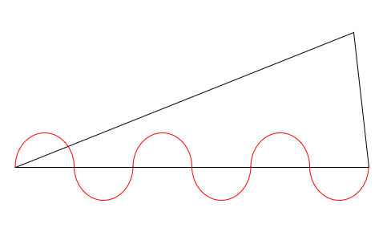
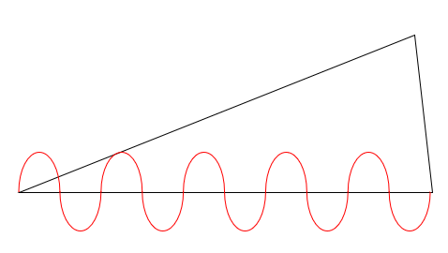
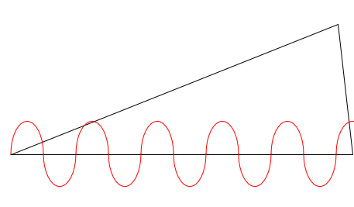
Triggering Phenomenon
Depending upon the chosen source of trigger, the DSO automatically locks to the integral number of frequency of the trigger source (in most cases) and generates a ramp signal whose time period is integral multiple to the triggering source frequency.
So it is to be kept in mind that if any signal (whether or not the trigger source) needs to be displayed on the screen –
“Ramp signal time period should be integral multiple of the signal.”
Integral Multiple
Integral Multiple
Non Integral Multiple

Slide 20
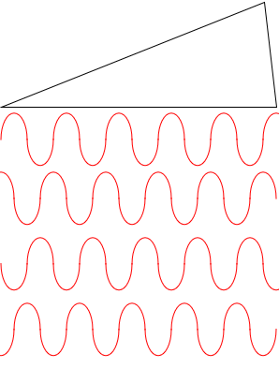
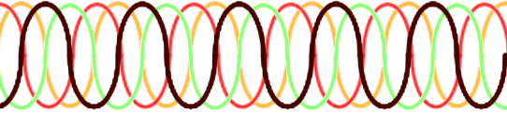
Triggering Phenomenon
If time period of the ramp signal is not an integral multiple of the signal to be represented on screen then signal shall appear on the screen in different orientation one after the other. Since the sec/div is very low, all these signal representations may appear simultaneously on the screen due to persistence of vision.
Signal display on the screen

Slide 21
Triggering Phenomenon
If there are two signals that are needed to be displayed on the screen, then in order to display both of them properly without multiple copies of any signal, the ramp signal time period should be integral multiple of LCM (or its multiples) of the 2 signals to be displayed.
For example
Signal 1 : 2 KHz (time period = 0.5msec)
Signal 2 : 5 KHz (time period = 0.2msec)
LCM = 1msec (2 cycles of 2 KHz signal and 5 cycles of 5KHz signal)
Therefore for representing both signals appropriately on the screen, if triggering with signal 1, then 2,4,6,8,… number of cycles should make up the ramp signal period.
Else if triggering with signal 2, then 5,10,15,20,…. number of cycles should make up the ramp signal.

Slide 22
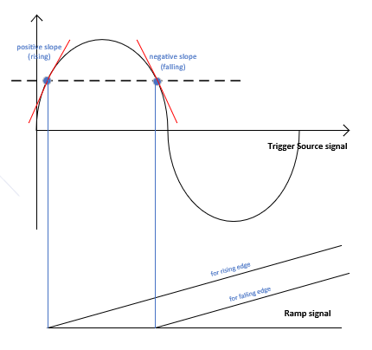
Triggering Phenomenon
Trigger Level is the starting point of the signal from which the ramp should start. It lies between the signal maximum and the minimum value. For the same voltage point any oscillating wave passes through that point twice with one having rising slope and other falling slope. Depending upon the slope chosen appropriate point from the two is selected for starting of the ramp signal.

Slide 23
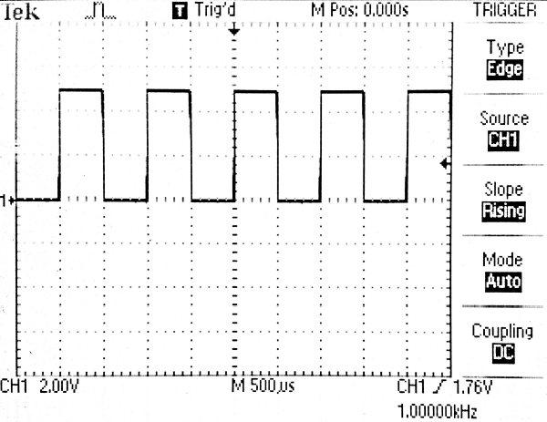
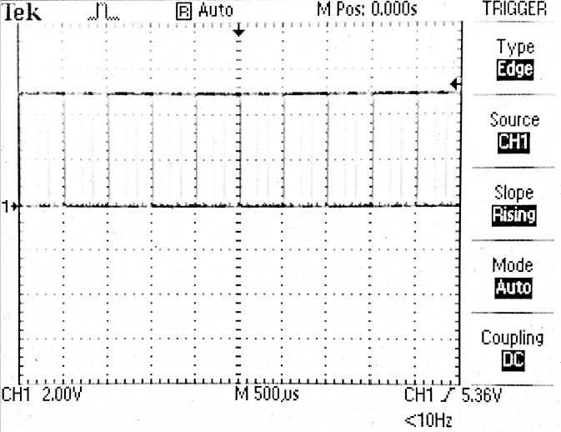
Trigger panel options - Trigger Level knob
It sets the trigger value. On rotating this knob, the trigger level moves vertically and is represented by the trigger pointer. The corresponding trigger level value could be viewed on the bottom right side of the screen. If the pointer goes out of the signal peak to peak (or allowable level) triggering won’t occur and multiple displays of the signal will appear on the screen (due to persistence of vision).
Trigger Pointer outside the allowed range
Allowed
Trigger points
Allowed
Trigger points
Trigger
Pointer

Slide 24
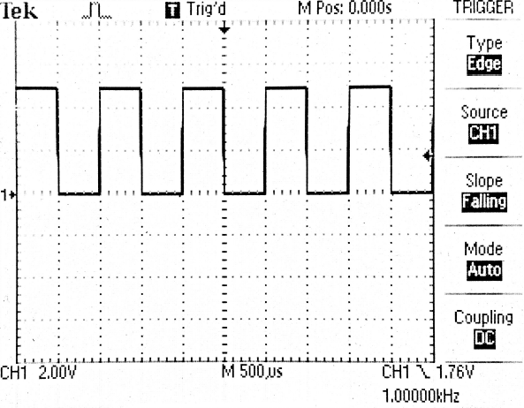
Trigger panel options -Trigger menu button
Trigger
Option 1: Trigger type – By default it is set to edge (used generally) we shall be limiting to this type now. Other types could be explored later using the help button.
Option 2: Trigger Source - Various sources are available for triggering purpose. All the channels available, mains, external signals could be used for triggering. Using mains the triggering is performed using the ac supply required to power the DSO. External signal for triggering could be provided using the external trigger BNC connector. Presently keep the triggering source to the channel corresponding to the signal connected (as only one channel is working).
Option 3: Slope - As discussed in triggering phenomenon slope could be selected to rising or falling.
Trigger
Source
Trigger
level
Slope
Falling Slope
Rising Slope
Trigger source
frequency

Slide 25
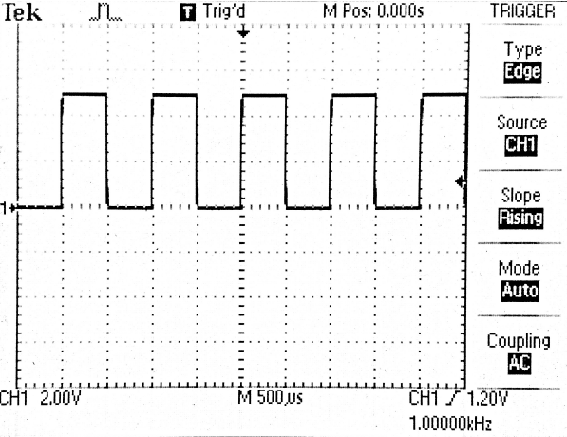
Trigger panel options -Trigger menu button
Option 4: Mode-
By default the mode is auto. In Normal mode the signal and triggering remains the same but in case when the signal goes out of
Option 5: Coupling-
DC coupling – default mode of coupling. Acceptable trigger level lies between the max and min value of the signal.
AC coupling – the acceptable trigger level lies between max and min value of the signal with DC part removed from it. (This could be realized as if the channel is AC coupled.)
HF reject, LF reject, etc – could be explored further.
trigger source
Allowed
trigger level
Ref. GND
Ref. GND
Allowed
trigger level
trigger source or DC coupled trigger source
AC coupled trigger source
DC Coupled
AC Coupled

Slide 26
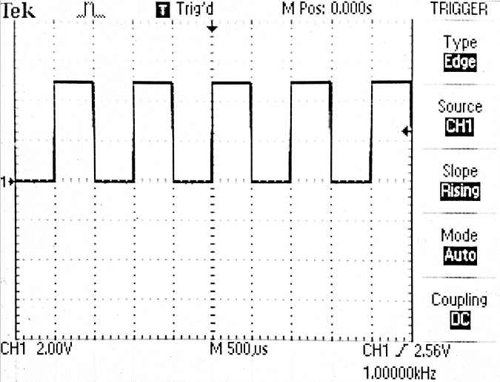
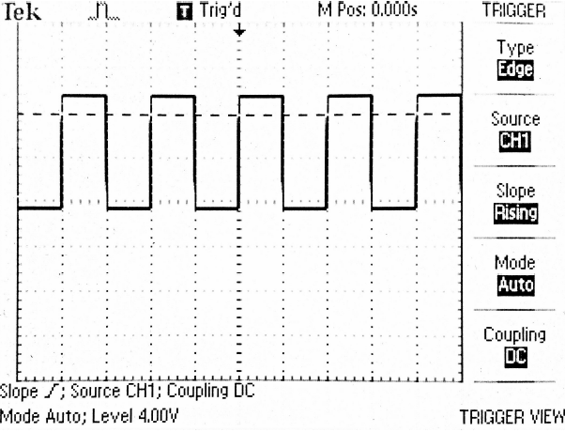
Trigger panel options - 50% trigger
It locates the trigger pointer or the trigger level to exactly 50% value or mid value of the signal.
Trigger panel options – Trigger View
It is used to display the trigger level by a dashed horizontal line on the display joining the trigger pointer. The line appears only when the button is pressed and vanishes on release.
50% trigger
level
Trigger
level view

Slide 27
Try out yourself
Apply different signals of same frequency on different channels and vary different options as discussed.
Try out different signals on XY display mode and observe various patterns and justify the figure using the electrodes configuration (vertical and horizontal) for displaying the signal.
Try out different signals of different frequencies and trigger properly.
Explore out remaining buttons on the panel.

